Slide 1
Organization Visiting: Streams Tech Ltd.
Course Name: Business Studies for Engineers
Course Code: BUS 405
Supervised by-
Mr. Md. Iftekharul Amin
Assistant Professor
Institute of Business Administration
University Of Dhaka

Slide 2
Presented by
Group-7
Abdullah Al Hadi(BSSE0823)
Aba Kowser(BSSE0825)
Suravi Akhter(BSSE0827)

Slide 3
Presentation Outline
Aim of the project
About the Organization
Vision and the Values
Organogram
Recruitment System
Organizational Culture
Involvement in Social Responsibility

Slide 4
Aim of the Project
To study the organizational culture
Know about the structure of an organization
Get an idea about the relationship between manager and employees
Know about environment of an organization

Slide 5
About the organization: Streams Tech Ltd.
Streams Technologies Limited is a software development company.
Established in January 2012 as a software development company in Bangladesh.
Software engineering, custom application development and system integration services specializes in GIS software.

Slide 6
Vision and Values: Streams Tech Ltd.
Vision : Organization provides full cycle support for software engineering, custom application development and system integration services.
Values :
Result Driven
Accountable & Transparent
Courageous & Respectful
Engaged & Inspired
Focused on Readers Interest

Slide 7
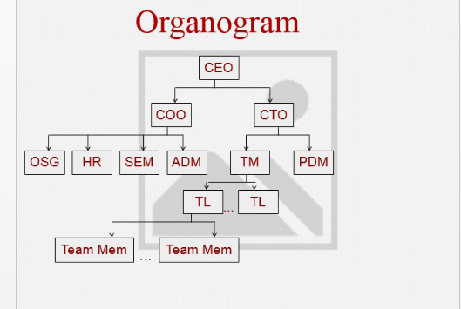
Organizational Structure: Streams Tech Ltd.

Slide 8
Recruitment System
Senior Employee: ​ - Advertisement in newspaper.​ - Daylong problem solving exam.​ - face to face interview.​ ​
Fresher Employee:​ - Day long problem solving exam.​ ​

Slide 9
Orienting new employees
All new employees are mentored by the seniors.
Current employees of the department are encouraged to hold informal workplace related discussions with new employees on topics such as goal, vision and history of the company.
New employees who struggle to cope up with the office environment are provided with the necessary training.
Current employees can informally pressurize the new employees to resign if performance is not satisfactory up to some certain level.

Slide 10
Culture of the Organization
All activities are performed maintaining the legal issues.
Expressing gratitude for work done is highly encouraged.
Greatly involved in maintaining social values.
All tasks must be approved by immediate senior
Special privileges are provided on the national important days.
Transparent and respectful to each other.

Slide 11
Involvement of Organization in Social Responsibility
It frequently organizes various competitions in multiple categories.
The winner of these competitions are rewarded so that they are encouraged in performing more constructive activities.
Jago foundation, Bidyanondo foundation.
Provide computer and financial help among poor students.
It responses in the time of disaster is well.

Slide 12
Informal Culture of the Organization
Many employees have their own workplace nicknames.
Various jargons are used in daily basis.
Birthdays of the employees as well as national festive days are celebrated in style and in most of the cases the readers joins the party is well.
Special discount is given at nationally or internationally important days like 21st February, Halloween festival etc.

Slide 13
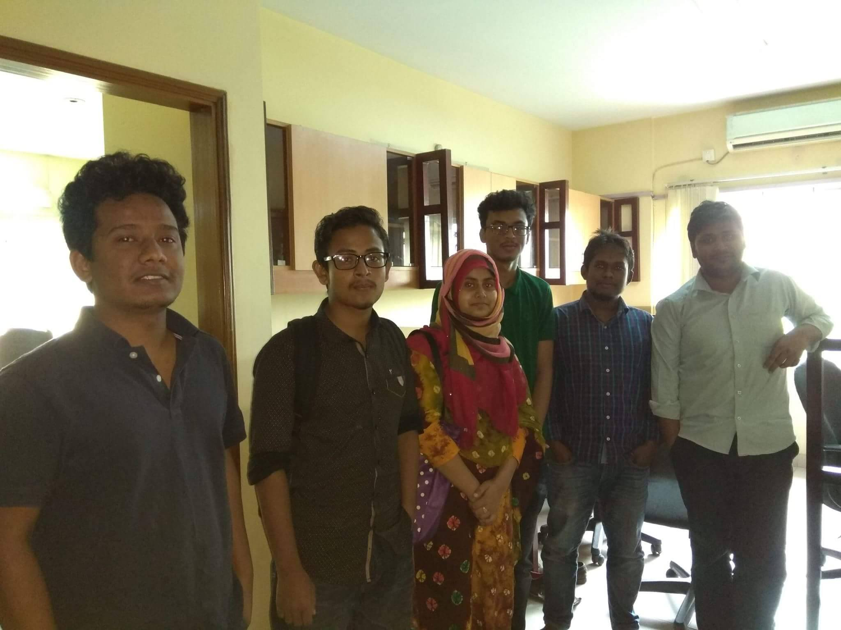
Memories....

Slide 14
Thank You!

